Slide 1
DATA MINING
© DR. Oluwatosin Oluwadare, 2024
Department of Computer Science , University of Colorado, Colorado springs.
CS 4434/5434 and dase 4435
Data Mining,
FALL 2024
Lecture 1: Course Overview

Slide 2
Introduction
Oluwatosin Oluwadare Ph.D.
Assistant Professor of Computer Science and Bachelor of Innovation
Office: Engineering Building - ENG 244
Phone: 719-255-3004
E-mail: ooluwada@uccs.edu
Website: https://uccs-bioinformatics.com/oluwatosin-oluwadare/

Slide 3
Research
Bioinformatics & Computational Biology
Machine learning & Data Mining
Deep Learning & Reinforcement Learning
Read more about my Research here:
GoogleScholar, ResearchGate, LinkedIn, PubMed

Slide 4
Now it’s your turn
Name, program
Prior courses/experiences related to this subject
Why did you register for this course?
Anything else

Slide 5
About Course
Time: Tues/Thurs 12:15pm -1:30pm
Classroom: ENG 101
Course Management: Canvas
For Grades posting and Announcements
Course Schedule/Website:
https://academics.uccs.edu/~ooluwada/courses/datamining/
All Resources, Projects, Homework, and Assignments will be posted on Course website.

Slide 6
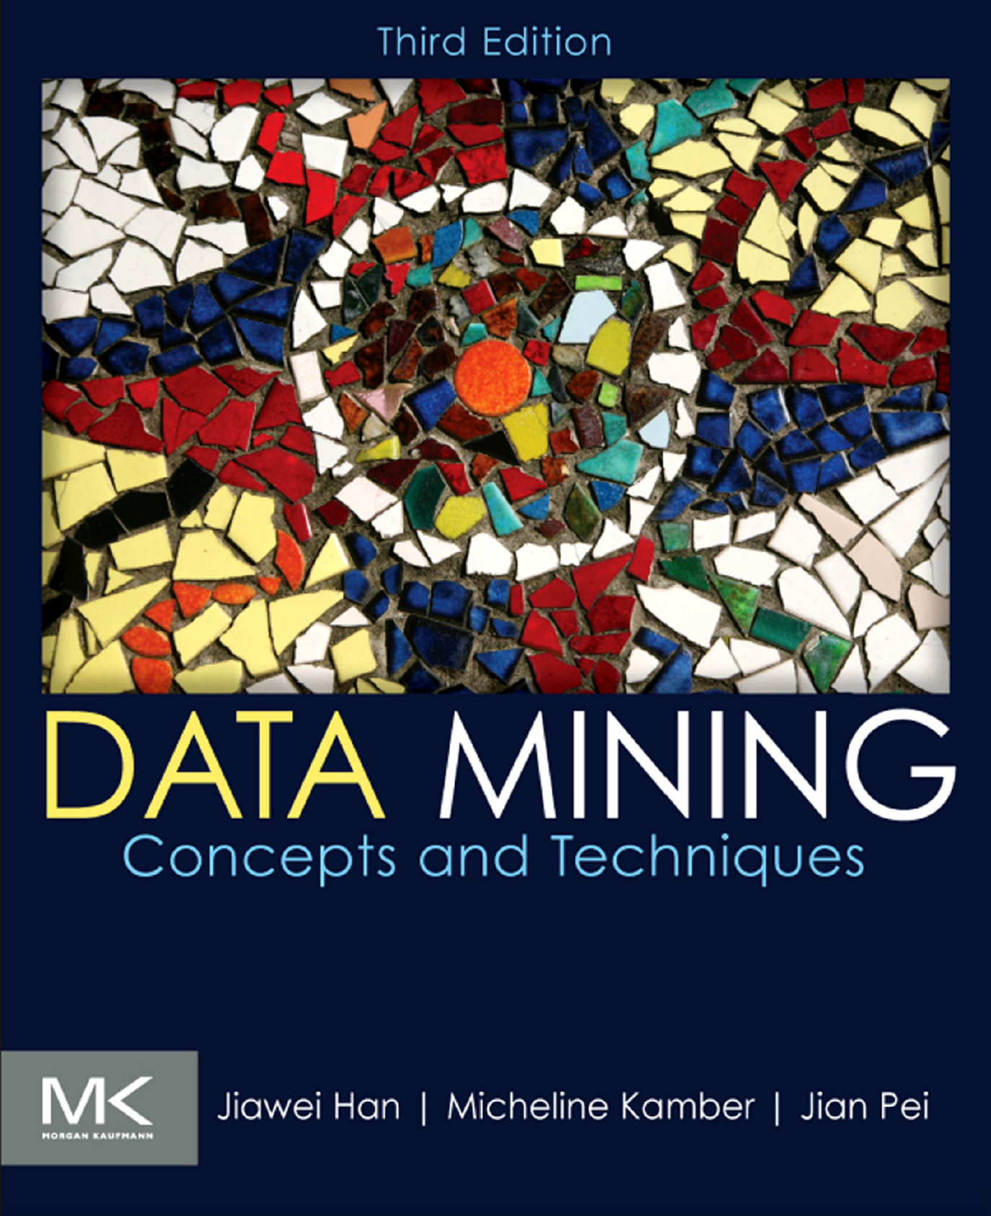
Textbook
(Required)Jiawei Han, Micheline Kamber, and Jian Pei. Data Mining: Concepts and Techniques, 3rd ed. (2nd edition is also fine), Morgan Kaufmann Publishers, June 2012. ISBN 9780123814791. Get an electronic copy from the UCCS Library.
References
Pang-Ning Tan, Michael Steinbach, and Vipin Kumar, Introduction to Data Mining, Addison-Wesley, 2006. ISBN 0-321-32136-7.
Christopher D. Manning, Prabhakar Raghavan and Hinrich Schütze, Introduction to Information Retrieval, Cambridge University Press. 2008. (This book is available online at http://nlp.stanford.edu/IR-book/)
Jure Leskovec, Anand Rajaraman, and Jeff Ullman. Mining of Massive Datasets, 2nd ed., Cambridge University Press. (Free book at http://www.mmds.org/#ver21)

Slide 7
The Slides
The slides highlight the gist of most important concepts and techniques.
But
It is not meant to be complete. Details may not be included.
It may be simplified for ease of explanation.
Studying only the slides is not enough.
You need to read the book and study the slides carefully.
Many lecture notes are adopted from:
Textbook: Jiawei Han (illinois)
Prof. Chengkai Li (UT-Arlington, Texas)
Prof. Jianlin Cheng (Mizzou)

Slide 8
Class Expectations
To be successful in this course, you (the student) need to attend every lecture. Students are required to attend lectures.
Participate in class discussions.
Ask questions for clarity.
Submit assignments and projects on time.

Slide 9
Class Pre-requisites
General Pre-requisite: Ability to code in R, Matlab or Python programming language and a good knowledge of data structures and algorithms.
For CS 5435: CS 4420/5420 Database System 1 or similar courses. If you haven’t taken a database course from anywhere, please get the consent of the instructor.
For CS 4434 or DASE 4435: CS 4420/5420 Database System 1 or consent of instructor.

Slide 10
Grading Scheme
Midterm Exam: 15% (Date: October 29, 2024)
Final Exam: 17% (Date: December 17, 2024)
Course Project: 35%. (Must be done independently)
Homework(HW): 25% (Must be done independently)
Reading Assignment: 8% (with presentation of the Research topic)
Final Letter Grade:
What you see on Canvas is what you get.
Undergraduate might get some questions(1 or 2) as bonus on assignments and exams

Slide 11
Homework (HW) : 25% of Class Grade
There will be four Homework (HW1, HW2, HW3, HW4)
6.25% each.
It will focus on :
Problem Solving,
Calculations, and
Relevant statistical analysis relevant to class topics.

Slide 12
Course Project (CP): 35% of Class Grade
There will be three course projects (CP1, CP2, CP3)
11.66% each
It will focus on:
hands-on experience with big data, real application
Must design, implement (programming), and evaluate,
open to novel solutions, and
Will be based on implementation of relevant algorithms studied in class

Slide 13
Course Project (CP) : 30% of Class Grade (cont’d)
Students will work on three course projects independently.
The project code and report should be submitted to Canvas on due date.
The number of pages for the report should be maximum of 2 pages or as instructed.
The report should include a title, student name, an abstract, an introduction to the problem, methods, results, conclusion, and references(if any).

Slide 14
Reading Assignment(RA) : 8% of Class Grade
There will be two reading assignments (RA1, RA2)
4% each: including Report and Presentation
A 5 mins presentation/discussion of the scientific paper in class.
It will focus on:
Getting extra knowledge on recent techniques and algorithms.
Improve student’s understanding of relevant algorithms studied in class.
A series of literature review for related topics and research-oriented project.

Slide 15
Programming Tools
Any general programming languages: C/C++, Java, Perl, Python
Specialized language packages: R, Matlab (or Octave)
Machine learning and data mining packages: Weka, NNClass, SVMlight

Slide 16
Canvas
Assignment solution file(.pdf, .doc, .docx)
Submission (we don’t accept email submission or hard-copy)
Grades.

Slide 17
Deadlines
Everything will be submitted through Canvas.
Due time: 11:59pm on Due Date provided on course website.
Late submission: 5-point deduction per hour, till you get 0. (The raw score of each assignment is 100. So, there is no point to submit it after 20 hours).

Slide 18
Regrading
Regrading request must be made within 7 days after we post scores on Canvas. Instructor or TA will handle regrade requests.
If student is not satisfied with the regarding results, you get 7 days to request again. The instructor will regrade, and the decision is final.
We don’t have a TA, so all report comes to me.

Slide 19
Announcements
Check Canvas regularly for announcements and updates.

Slide 20
Course Review
We will have a course review at least once before the semester ends to ensure a smooth running of the class.
Check the course schedule for the dates we have scheduled for this.

Slide 21
Academic Integrity
Cheating
Copying another's test or assignment
Communication with another during an exam or assignment (i.e. written, oral or otherwise)
Giving or seeking aid from another when not permitted by the instructor
Possessing or using unauthorized materials during the test
Buying, using, stealing, transporting, or soliciting a test, draft of a test, or answer key

Slide 22
Academic Integrity
Plagiarism
Using someone else's work in your assignment without appropriate acknowledgement
Making slight variations in the language and then failing to give credit to the source
Collusion
Without authorization, collaborating with another when preparing an assignment

Slide 23
Reasons why you chose the Right class?
Stephen Brodsky, distinguished engineer and technical executive at IBM, 2013

Slide 24
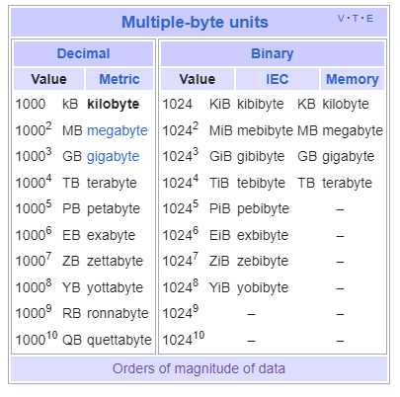
Big Data Age
Booch, 2013
Notes:
The world's technological per-capita capacity to store information has roughly doubled every 40 months since the 1980s;^{[9]} as of 2012, every day 2.5 exabytes (2.5×10¹⁸) of data are generated.[

Slide 25
Wikipedia/images

Slide 26
Big Data Age
In the Scientific Research Community
Field | Source | Data Type
Physics | Large Hadron Collider [About LHC](2 mins) [LHC Data] (5 mins) | Collisions
Genomics | High-throughput instrument [Video] | DNA Sequence
Astronomy | Large Synoptic Survey Telescope(LSST) | Telescope images
Meteorology | Weather stations, ships, buoys, aircraft, radar, weather balloons, and satellite

Slide 27
Case Study 1: Physics, Collisions in LHC
Particles collide in the Large Hadron Collider (LHC) detectors approximately 1 billion times per second, generating about one petabyte of collision data per second. A 'trigger' system is therefore used to filter the data and select those events that are potentially interesting for further analysis. 30 millions events to 100,000 events
Even after the drastic data reduction performed by the experiments, the CERN Data Centers processes on average one petabyte of data per day.
"If we wanted to keep all 30 million events per second we would need about 2,000 petabytes to store a typical 12-hour run. For a typical running year of 150 days uptime, this would mean almost 400,000 PetaByte = 400 ExaByte per year - a huge amount of data we would not be able to store," CERN research physicist”
1) https://home.cern/science/computing/storage
2) https://home.cern/news/news/computing/cern-data-centre-passes-200-petabyte-milestone#:~:text=Particles%20collide%20in%20the%20Large,of%20collision%20data%20per%20second

Slide 28
Case Study 2: Genomics
doi:10.1371/journal.pbio.1002195.g001

Slide 29
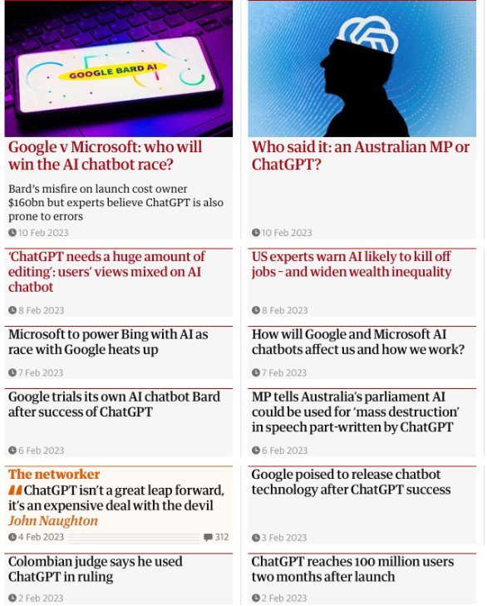
Case Study 3: Generative AI

Slide 30
ChatGPT model parameter size
https://www.stylefactoryproductions.com/blog/chatgpt-statistics

Slide 31
ChatGPT Training dataset Size
https://www.stylefactoryproductions.com/blog/chatgpt-statistics​

Slide 32
ChatGPT Training Data
https://www.stylefactoryproductions.com/blog/chatgpt-statistics​

Slide 33
ChatGPT Statistics
In January 2024, ChatGPT’s website averaged around 54 million unique visitors every day.
https://www.stylefactoryproductions.com/blog/chatgpt-statistics

Slide 34
What is Big Data?
It refers to large set of data that is almost impossible to manage and process using traditional or commonly used business intelligence software tools within a tolerable elapsed time.
Magoulas, Roger; Lorica, Ben (February 2009). "Introduction to Big Data". Release 2.0. Sebastopol CA: O'Reilly Media. [Extra Reading]
What qualifies as being "big data" varies depending on the capabilities of the users and their tools, and expanding capabilities make big data a moving target. ”
For some organizations, facing hundreds of gigabytes of data for the first time may trigger a need to reconsider data management options. For others, it may take tens or hundreds of terabytes before data size becomes a significant consideration.

Slide 35
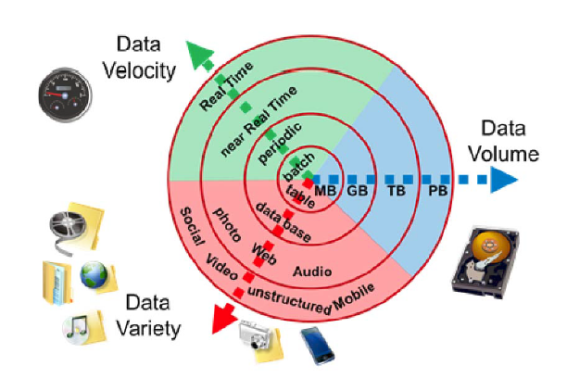
Big Data - Components
The main Components of big data is data that contains greater variety, arriving in increasing volumes and with more velocity. This is also known as the three Vs.
Image source: https://commons.wikimedia.org/wiki/File:Big_Data.png

Slide 36
Big Data – Components (cont’d)
Off course these are not the main characteristics proposed, as many revisions have been made.
Two more Vs have emerged [1-3].
When more components such as Value and Veracity have been introduced, they are often referred to as the "four Vs", and "five Vs” when it
V’s veracity, referring to the quality of the data, and value referring to the usefulness of the data
Today, even more qualities have been defined: relationality, exhaustivity, etc. [4]
1. Onay, Ceylan; Öztürk, Elif (2018). "A review of credit scoring research in the age of Big Data". Journal of Financial Regulation and Compliance. 26 (3): 382–405. doi:10.1108/JFRC-06-2017-0054. S2CID 158895306.
2. Laney, D. (2001) 3D Data Management: Controlling Data Volume, Velocity and Variety. META Group Research Note, 6.
3. Frizzo-Barker, J., Chow-White, P. A., Mozafari, M., & Ha, D. (2016). An empirical study of the rise of big data in business scholarship. International Journal of Information Management, 36(3), 403-413.
4. Kitchin, R., & McArdle, G. (2016). What makes Big Data, Big Data? Exploring the ontological characteristics of 26 datasets. Big Data & Society, 3(1), 2053951716631130.

Slide 37
Source: Creative Commons Image License from Microsoft Bing Search
https://insightextractor.com/data-variety-big-data/

Slide 38
Reasons why you chose the Right class?
Lot’s of Jobs:
https://www.linkedin.com/jobs/data-mining-jobs/
https://www.glassdoor.com/Job/data-mining-jobs-SRCH_KO0,11.htm
https://www.indeed.com/q-Data-Scientist-jobs.html
Google.images

Slide 39
Extra Reading
Extra’s that will be beneficial for the currently discussed topic in class.
For example: Lecture 1 extra Reading answers the following questions:
Why Big Data Matters?
What are the Big Data Technologies?
Heard about MapReduce, GFS, and Hadoop(HDFS)?
How does it work?
Big Data: Astronomical or Genomical?

Slide 40
Extra Reading
Big Data
Sagiroglu, S., & Sinanc, D. (2013, May). Big data: A review. In 2013 international conference on collaboration technologies and systems (CTS) (pp. 42-47). IEEE.
Big Data: Astronomical or Genomical?
Stephens ZD, Lee SY, Faghri F, Campbell RH, Zhai C, Efron MJ, Iyer R, Schatz MC, Sinha S, Robinson GE. Big data: astronomical or genomical?. PLoS biology. 2015 Jul 7;13(7):e1002195.
Release 2.0: Issue 11–Big Data
Magoulas, Roger; Lorica, Ben (February 2009). "Introduction to Big Data". Release 2.0. Sebastopol CA: O'Reilly Media.

Slide 41
Questions?
Let’s have a great semester

Slide 42
Graduate Research Opportunities in Bioinformatics Lab
The Dr. Oluwadare’s Bioinformatics Lab led by Oluwatosin Oluwadare Ph.D. is looking for highly motivated and hardworking Ph.D. and M.Sc. students.
We are focused on the application of deep learning and machine learning algorithms to solve interesting and important biological problems.
Please contact Dr. Oluwadare at ooluwada@uccs.edu if you are interested in pursuing this opportunity.
There is no current opening for Fall 2024

